Slide 1
Sprout Monitoring System
41EC L01 – Internet of Things (Iot)

Slide 2
Contents:
Abstract
Introduction
Drawbacks
Proposal method
Problem statement
Problem solution

Slide 3
Continued .,
Block diagram
Flow chart
Components and sensors
Work plan
Results
Lean canvas and Business canvas
Conclusion

Slide 4
Abstract
Innovative element of our product is automated sprouting system using IOT (Internet of Things). The overall idea is to develop and prevent sprout spoilage or pre matured rate of sprouting .
The sensor DHT 11 is used to monitor the temperature and humidity of the closed system .The temperature maintained in the system is around (70- 80 F) and the humidity level is around (30- 40 %) in a closed environment.
The chamber is constructed as covered steel chamber with thermocol bended layer with proper air circulation. The data which are collected from the system are send to cloud (Thinks speaks).

Slide 5
Introduction:
Sprouting of cereals is the process where it enrich the protein content in the cereals .
Basically sprouting needs some specific parameters such as temperature and humidity.
Sprout monitoring system can be able to maintain specific parameters and to enrich the protein in cereals .
Temperature and humidity are used to monitoring the cereals for better production of protein.

Slide 6
Drawbacks of Existing System:
In early days, the grains are first rinsed to remove soil, dirt and the mucilaginous substances produced by some grains when they come in contact with water. Then they are soaked for 20 minutes to 12 hours, depending on the type and size of grains. The soaking increases the water content in the grains and brings them out of quiescence.
After draining and then rinsing grains at regular intervals they germinate, or sprout.
In this case, if the moisture content is increased, the cereals gets spoiled and produces foul smell and if the temperature gets increased the cereals may stop the sprouts.

Slide 7
Proposal Method:
Temperature sensor used to monitor and maintain the cereals throughout the process.
Humidity sensor is used to control the spoilage of cereals and foul smell.

Slide 8
Problem Statement:
Malnutrition denotes impairment of health arising either from deficiency or excess or imbalance of nutrients in the body.
Indeed, in today’s fast-food environment, the adequacy of individual’s diets is questionable, perhaps because of the potential inadequacy of essential nutrients in individual’s diets, the use of nutritional supplementation is often examined.
We need 0.8g of protein per kilogram of our body weight and it keeps immune system strong. The individuals may not attain the daily consumption this may leads to major health defect in an individuals.

Slide 9
Problem Solution:
Grains are rich in protein and fibre content when the grains start to sprout the fibres content get reduced and the protein content is enriched .
The sprouting process are done under the monitoring system to reduce the spoilage of grains and to get the proper enrichment of protein content after the grains sprouts.

Slide 10
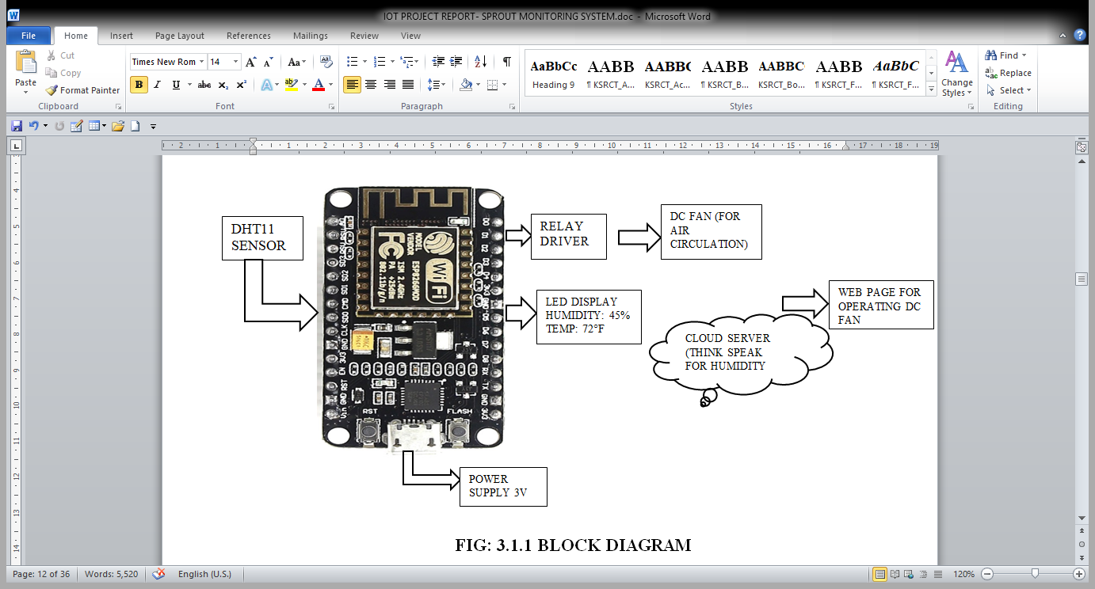
Experimental Setup:
Fig.2: Block Diagram

Slide 11
Flow Chart:
Components are collected such asESP8266, Bread Board, DHT11 sensor, male and female wires.
Arduino IDE software was selected with respect to the ESP 8266 (Nodemcu) board
Programs was scripted for DHT11 sensor and connected to cloud for those data as a database.

Slide 12
Continued .,
The chamber was constructed using aluminium sheet with doubled layer sealed with thermacol
The sensor was fixed inside the chamber and the grains are introduced into the chamber
The sprouts are collected and the protein content was done through Lowry's et al.,(1951) method.

Slide 13
Components and Sensors:
DHT 11 Sensor
ESP 8266 Module (NODEMCU)
DC Fan
Male and Female Wires
Data Cable
Bread Board

Slide 14
DHT Sensor:
DHT ( sensor used to sense both temperature and humidity by NTC and IC where "NTC” means “Negative Temperature Coefficient”, which means that the resistance decreases with increase of the temperature.
DHT11 temperature range is from 0 to 50 degrees Celsius with + or -2 degrees accuracy.
The DHT11 humidity range is from 20 to 80% with 5% accuracy.

Slide 15
Continued .,
There are two specification where the DHT11 is better than the DHT22. That’s the sampling rate which for the DHT11 is 1Hz or one reading every second, while the DHT22 sampling rate is 0, 5Hz or one reading every two seconds and also the DHT11 has smaller body size.
The operating voltage of both sensors is from 3 to 5 volts, while the max current used when measuring is 2.5mA.

Slide 16
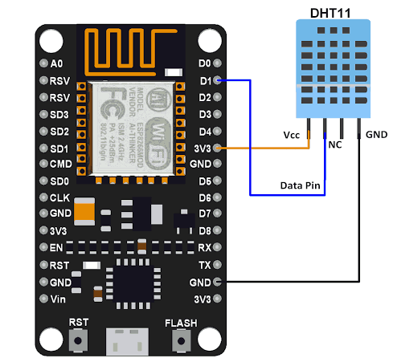
PIN Diagram:
Fig.3: Esp8266 DHT11 Connection

Slide 17
NODEMCU:
Node MCU is an open source IOT platform. Nodemcu development kit/ board consist of ESP8266 WIFI chip.
ESP8266 chip has GIPO pins, serial communication protocol, etc. It includes firmware which runs on the ESP8266 Wi-Fi SOC from expressive systems, and hardware which is based on the ESP-12 module.
The ESP8266 module or simply the ESP-01 module offers a complete and self-contained Wi-Fi networking solution, allowing it to either host the application or to offload all WI-FI networking functions from another application processor

Slide 18
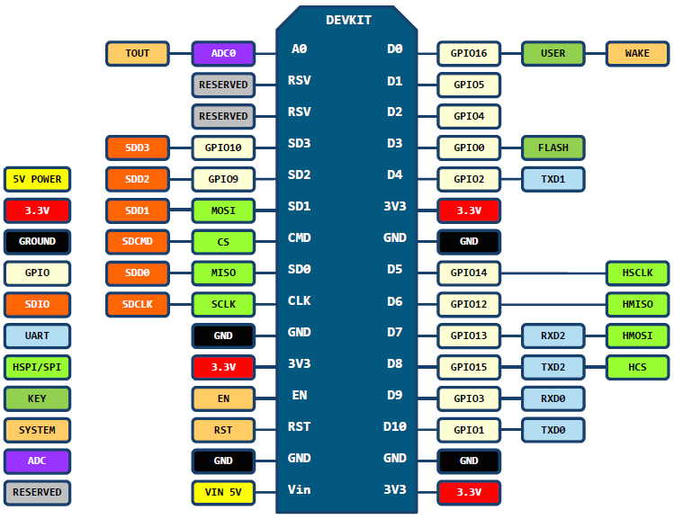
PIN Diagram:
Fig.4: Pin Diagram for Es8266

Slide 19
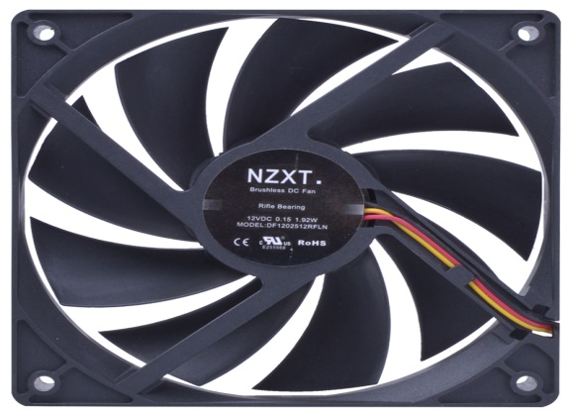
DC Fan:
An electric Fan is an electric motor attached with blades. If this motor is designed to work on AC it will run on AC, if it designed to run on DC it will run on DC.
However DC series motor can run on both DC and AC.
Fig.5: DC Fan

Slide 20
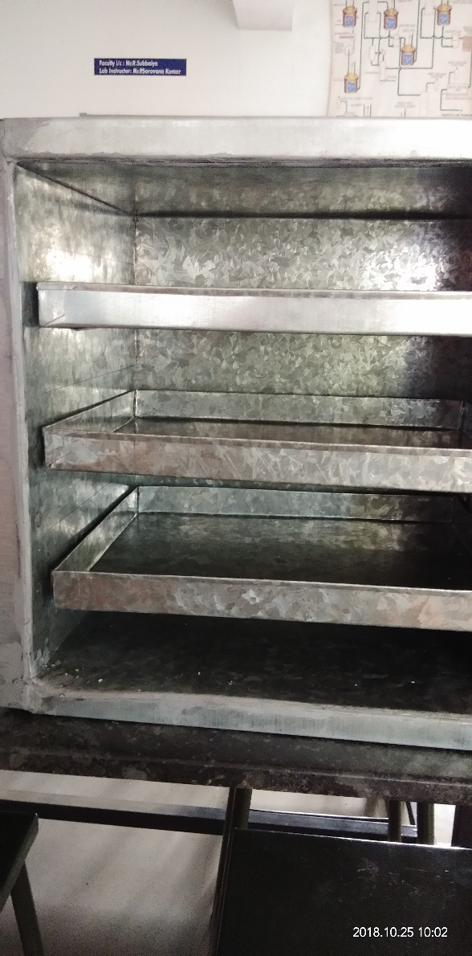

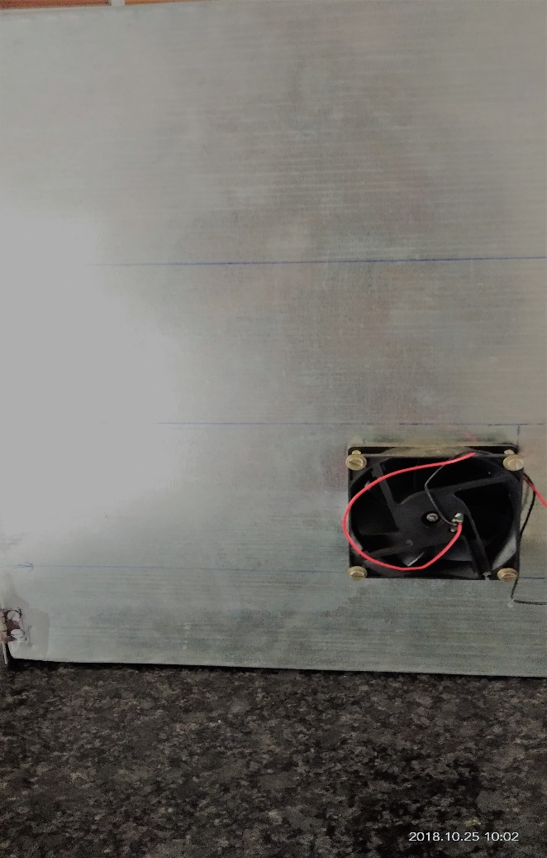
Construction of chamber:
1. Inside view
2. Front view
3. Side view
Fig.6: Overview of Sprouted Multi -Chamber

Slide 21
Working:
Cereals are sprouted by utilizing the required temperature and humidity in a proper conditions.
Where the conventional method does not have those in proper such as if the humidity level increases the cereals may get foul smell , if temperature is higher it may stop sprouting.
To estimate the protein content by Lowry’s et al method (1951).

Slide 22
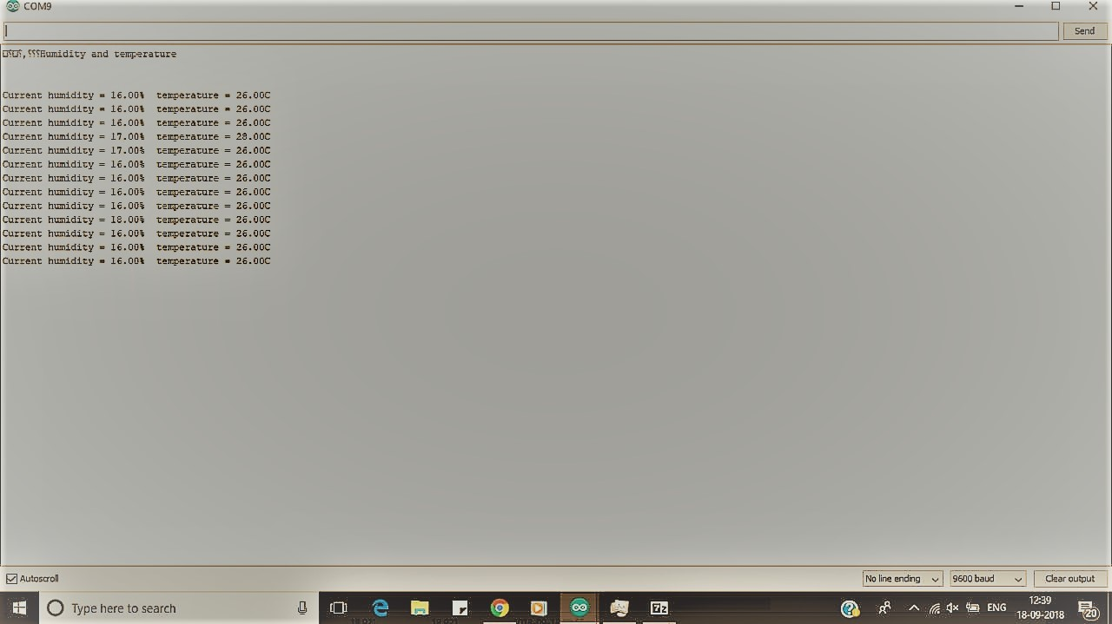
Results and Conclusion:
This is used to monitor the Temperature and Humidity of the Sprout Monitoring System using IOT.
Fig.7: Output Image Dht11 Sensor

Slide 23
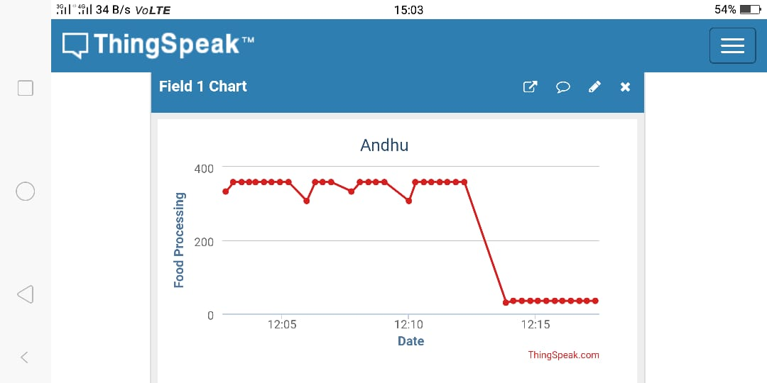
Cloud Storage:
Fig.8: Cloud Storage by ThingSpeak

Slide 24
Continued.,
The grains are powdered and protein estimation by Lowry’s et al.,(1951) was done.
Sample | Protein content in Conventional Method (mg/ml) | Protein content in Sprouted seed Monitoring System (mg/ml)
Green gram | 0.678 | 0.734
Pearl millet | 0.473 | 0.540
Finger millet | 0.589 | 0.627
Black chickpeas | 0.729 | 0.846
Sorghum | 0.493 | 0.549
Fig.9: Estimation of Protein content

Slide 25
Protein Estimation Graph:
Fig.10: Comparative Studies

Slide 26
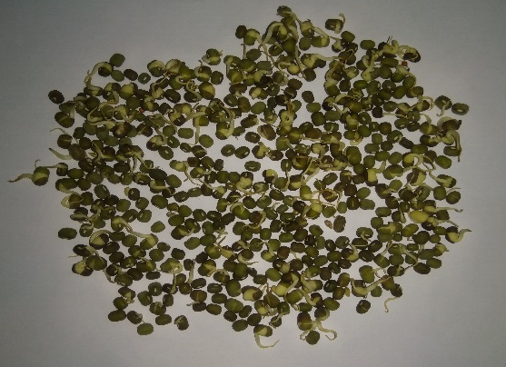
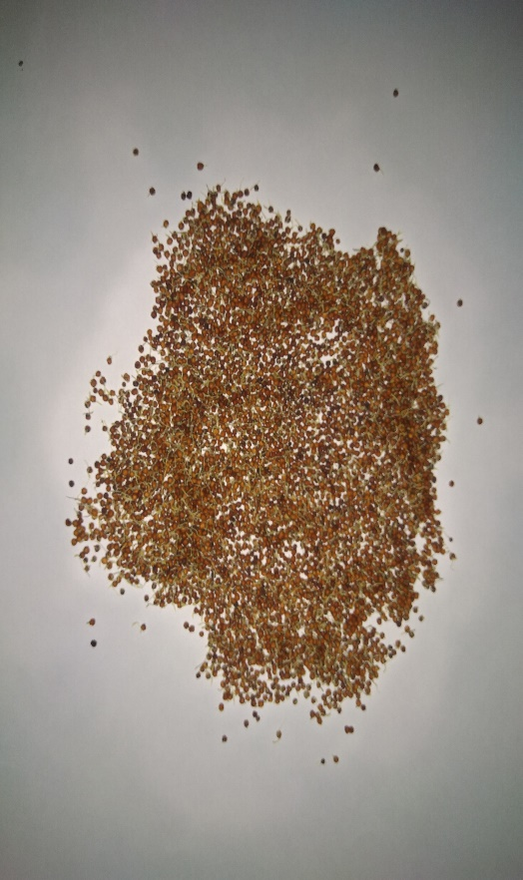
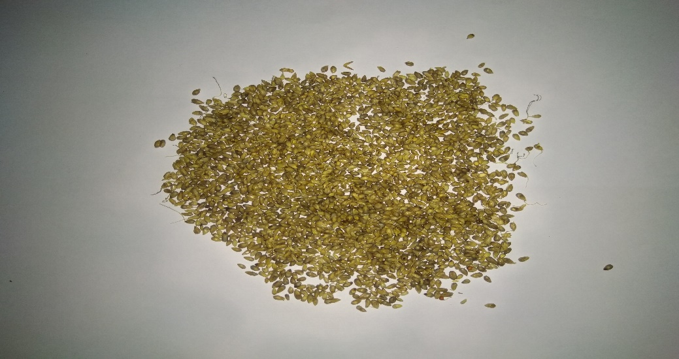
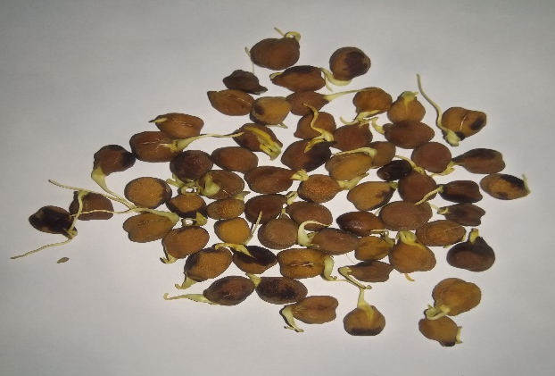
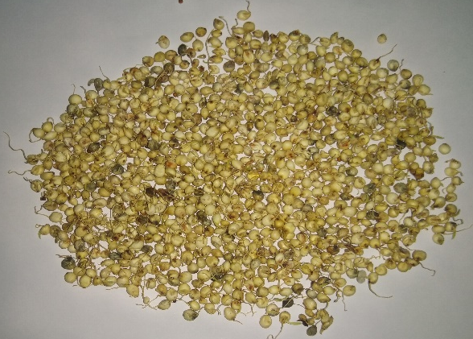
List of Sprouted Grains:
Fig.11: Green gram
Fig.12: Pearl millet
Fig.13: Finger millet
Fig.14: Black chickpeas
Fig.15: Sorghum

Slide 27
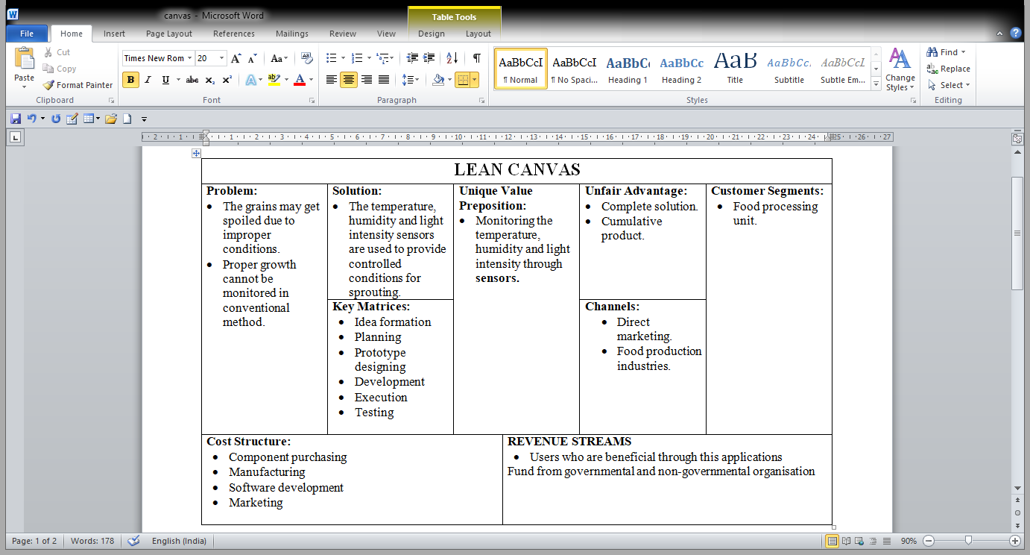

Slide 28


Slide 29
Conclusion:
The proposed speed sprout includes monitoring function, which enables user to monitor the temperature and humidity and light intensity in a sprout monitoring wirelessly and control function which is able to control the condition in the seed.
The monitoring system was able to acquire sensor data and send the data to Thing speak online cloud for monitoring and storage. The data could be accessed by the user anytime by using a computer that is connected to the Internet.
The Cereals sprouted in chambers has high protein content than conventionally sprouted cereals.

Slide 30
Bill of Materials:
S.No | Details of Expenditure | Amount
1 | Aluminium Chamber | Rs.3000
2 | ESP8266 Module | Rs.600
3 | Humidity Sensor(DHT11) | Rs.450
4 | Male & Female Wires | Rs.60
5 | Bread Board | Rs.40

Slide 31

THANK YOU

